Slide 1

Logistic Regression

Slide 2
Introduction
Supervised Learning
Classification Problem
When we classify only two classes it is called Binary Classification problem.
Logistic Regression is a type of regression analysis used for predicting the outcome of dependent variable.
Dependent variable(Y) is binary(0,1) and independent variables (X) are continuous in nature.
Dependent variable can take only two possible values such as “Yes or No”, “Default or No Default”, “Living or Dead”, “Responder or Non Responder”, “Yes or No” etc.

Slide 3
Logistic Regression
The dependent variable Y must be categorical (1/0) and take binary value.
e.g: if pass then Y = 1;else Y = 0
We need a hypothesis function or we can call it a model.
The output of this hypothesis should be between 0 and 1.
We use sigmoid function as the hypothesis.
Thus the goal of the Logistic Regression is to predict the likelihood that Y is equal to 1 (probability that Y = 1 rather than 0),given certain values of X.

Slide 4
Why not use linear regression??

Slide 5
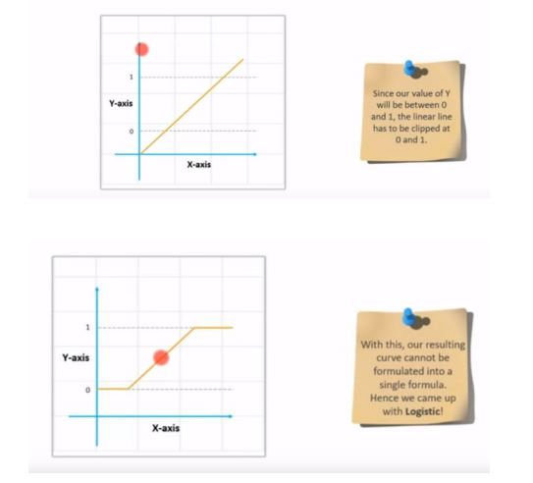

Slide 6
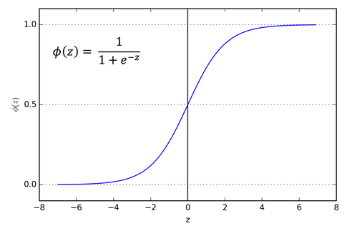
Why Sigmoid??

Slide 7
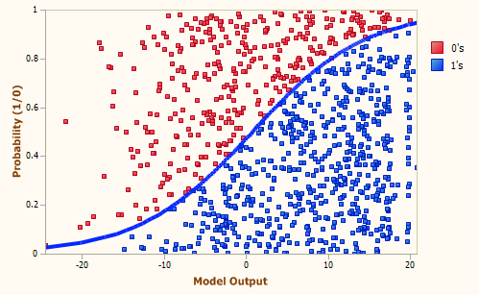
Binary Classification

Slide 8
Decision Boundary
We deal with thresholds here.
Suppose if we have any value at 0.8 then we define threshold and if the value is greater than threshold that will be rounded off to 1,less than threshold rounded off to 0,in order to find the output
If hypothesis >= 0.5 yhat = 1
else yhat = 0
Here Theta’s play an important role in creating the decision boundary
Once we have the decision boundary set we will not need any data to predict the output
We can build complex boundaries if we use higher order H-functions

Slide 9
Cost Function
This is the cost function we used previously:
Here we introduce a new kind of loss function called cross entropy loss.

Slide 10
Cross entropy loss
We will define loss function for logistic regression like this:
cost(h(x),y) = -log(h(x)) if y = 1
= -log(1-h(x)) if y = 0
So, we derive the loss function from the above formula with the help of principle of maximum likelyhood estimation

Slide 11
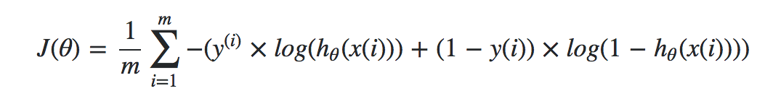
Loss function
This is how cross entropy loss looks like:
Here ‘m’ is the number of training examples used

Slide 12
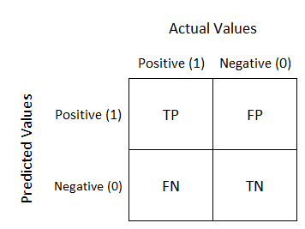
Evaluation Metrics
There will be four possibilities if we consider a match win/loss prediction:
Model Predicted win and team win – True Positive (TP)
Model Predicted win and team lost – False Positive (FP)
Model Predicted loss and team win – False Negative (FN)
Model Predicted loss and team loss – True Negative (TN)
Confusion Matrix is the Classification Metric used to describe the performance of a classification model on a set of test data for which the true values are known.

Slide 13
Evaluation Metrics
Model accuracy - Accuracy is the most intuitive performance measure and it is simply a ratio of correctly predicted observation to the total observations.
TP+TN / TP+FP+FN+TN
Precision- Precision is the ratio of correctly predicted positive observations to the total predicted positive observations
TP / TP + FP
Recall(Sensitivity) It is the ratio of correctly predicted positive observations to the all observations in actual class - yes TP / TP + FN
F-Measure It is the weighted average of Precision and Recall. Therefore, this score takes both false positives and false negatives into account
2 * Precision * Recall / Precision + Recall

Slide 14
Multiclass Classification
Till now we dealt with only binary classification
Now in the real word we might have classes more than two, called as Multinomial Logistic Regression.
Ex- email Foldering: we have many classes like work, family, friends etc.
We use the concept of one vs all.

Slide 15
One Vs all approach
We take the training sets and we separate them into different binary classification problems
Such that in each training set only one class is labeled as one and others as 0
So, we train a classifier on each dataset and we get different H-functions.

Slide 16
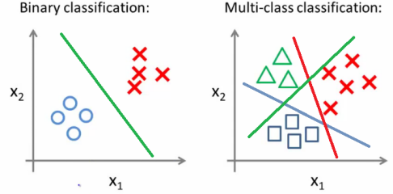
One Vs All approach
Lets take this example:

Slide 17
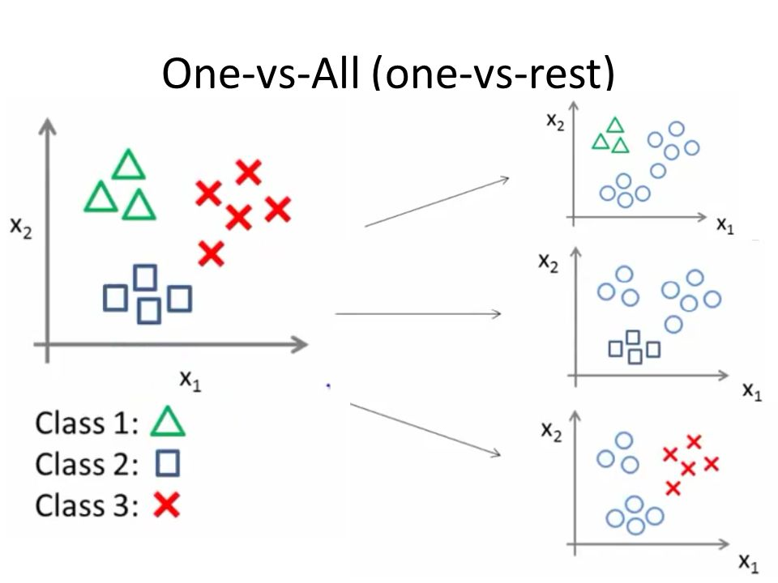
One Vs All approach
We divide the data like this:

Slide 18
Addressing Overfitting
We can use the idea of regularization
In regularization we keep all the features and reduce the magnitude of the parameters
We can control regularization by using a parameter
When we use regularization we need to make small modifications in both the loss and gradient descent and also using resampling techniques like k-fold cross validation.

